Slide 1
R-OTE 4.5.1
Bob Anderson upgrades the versatile Occultation Timing Extraction tool
By Tony George
Presented at 2016 IOTA Conference – Stillwell, Oklahoma

Slide 2
R-OTE History (R-code Occultation Timing Extractor)
Three versions of R-OTE have been written to date:
Version 3.1.1 was first released on 10-4-2013 introduced a new occultation search technology
Version 3.8.2 major update on 7-29-2014 introduced several new features
Version 4.5.1 released on May 1, 2016 introduces many improvements
I will review the earlier version features and then introduce the features in the latest update

Slide 3
R-OTE, because it is based on R and Rstudio, is multi-platform compatible. It will run on:
Windows 7 or Windows 10
Apple OS X
A variety of Unix systems
Linux
Or any system that will run with R, RStudio, and a web browser.

Slide 4
R-OTE Requires:
R
R is an interpreted computer language that contains functionality for a large number of statistical procedures used in R-OTE
R must be installed on your computer.
Rstudio
Rstudio is an integrated development environment (IDE) for R and includes a wide range of productivity enhancing features and runs on all major platforms. It provides the interface between R and your web browser.
Rstudio must be installed on your computer.
Web browser such as Safari (Mac), Google Chrome, Internet Explorer, etc.

Slide 5
R-OTE 3.1.1 Description
R-OTE was initially intended as an upgrade and replacement to Occular 4.0, also written by Bob Anderson.
R-OTE is a 'likelihood-based' statistical analysis of the light curve and as such is computationally different from Occular 4.0
R-OTE research identified the concept of noise asymmetry in the light curve between the baseline noise and event noise
Here is a light curve where asymmetric noise during the event is much lower than in the baseline.

Slide 6
R-OTE 3.1.1 Description (cont.)
R-OTE contains a statistically based AIC (Akaike information criterion) test of detected occultation events, to determine if the 'event' is likely real, or instead, more likely due to the random fluctuations of noise in the otherwise straight or flat light curve. This reduces the amount of ‘judgment’ required to interpret if an event is statistically valid.
AIC eliminates the need for interpretation of the ‘Occular Confidence Level’ used in Occular.

Slide 7
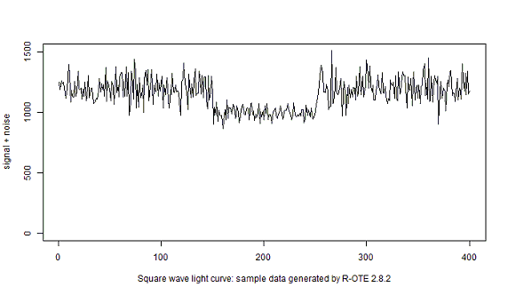
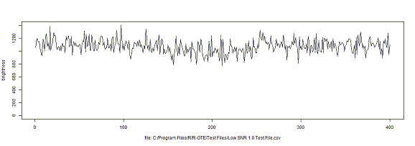
R-OTE 3.1.1 Description (cont.)
R-OTE is optimized to find both clear events in high SNR data and difficult events in noisy low-SNR data
High SNR event
Low SNR event

Slide 8
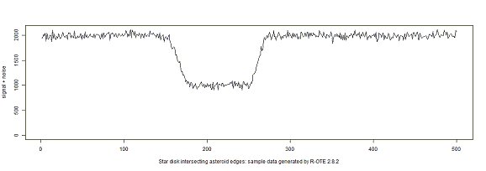
R-OTE 3.1.1 Description (cont.)
R-OTE is enhanced to allow analysis of gradual transitions caused by large stars and stellar limb darkening
A test data set generator was provided to create test files with known D and R events

Slide 9
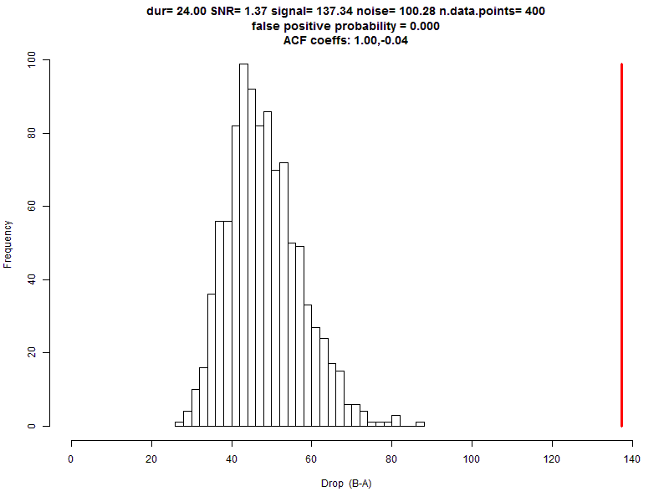
R-OTE 3.1.1 Description (cont.)
R-OTE includes a ‘False Positive’ analysis to further differentiate real events from false events caused by noise
Noise from an ‘event’ is added to a straight line 5000 times. Each run is analyzed to see if there are any events with the same duration as the detected event. A histogram of the detected magnitude drops is produced and compared to the actual magnitude drop for the ‘event’. A wide separation between the histogram and the detected magnitude drop indicates the ‘event’ is not due to noise [it doesn’t however have to be from an occultation, it could be caused by atmospheric artifacts or processing artifacts such as hot pixels in the measuring aperture(s)]. This test can be rerun for a range of event durations.

Slide 10
R-OTE 3.8.1 upgraded many features
Added the ability to directly read Limovie and Tangra .csv files
Automatically interpolates Tangra blank entries
Added a Fourier filter for the analysis of light curves with cyclical variations due to AC voltage interference, drift scan microlensing effects, or scintillation
Added ability to use a secondary light curve for detrending the primary light curve

Slide 11
R-OTE 3.8.1 Fourier Filter examples
Measured actual drift-scan light curve from an artificial star using a camera with known micro-lensing behavior
[courtesy of Gerhard Dangl]
Fourier filter analysis of above light curve
Fourier-filtered light curve with micro-lensing signal removed

Slide 12
R-OTE 4.5.1
Numerous minor code errors fixed
GUI improvements made to ease and speed up operation
Progress bars added for time-intensive calculations
.csv files checked for time stamp continuity, with minor issues automatically fixed
Provides for camera delay and VTI offset corrections
Supports both NTSC and PAL in menu selections
Primary star light curve can be normalized to a secondary star light curve
The time correlation between a primary light curve and the secondary light curve can be determined and, if appropriate, a relative shift between light curves can be applied
Correlated noise utilized in the calculation of error bars – R-OTE is the first and only OTE program to calculate error bars correctly for correlated noise at all confidence intervals.
SQ wave error bars are user selectable between 0.5 and 0.9973 confidence level.
Camera integration can be simulated in generated light curves

Slide 13
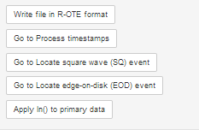
GUI Improvements
Menus contain multiple “Go to” shortcut buttons – saving keystrokes and time

Slide 14
Progress Bars added
In previous versions of R-OTE , the user had to watch the Rstudio screen to gauge the progress of time-intensive calculations. Now, a progress bar pops up (sometimes underneath other screens) and indicates the percent of calculations completed.

Slide 15
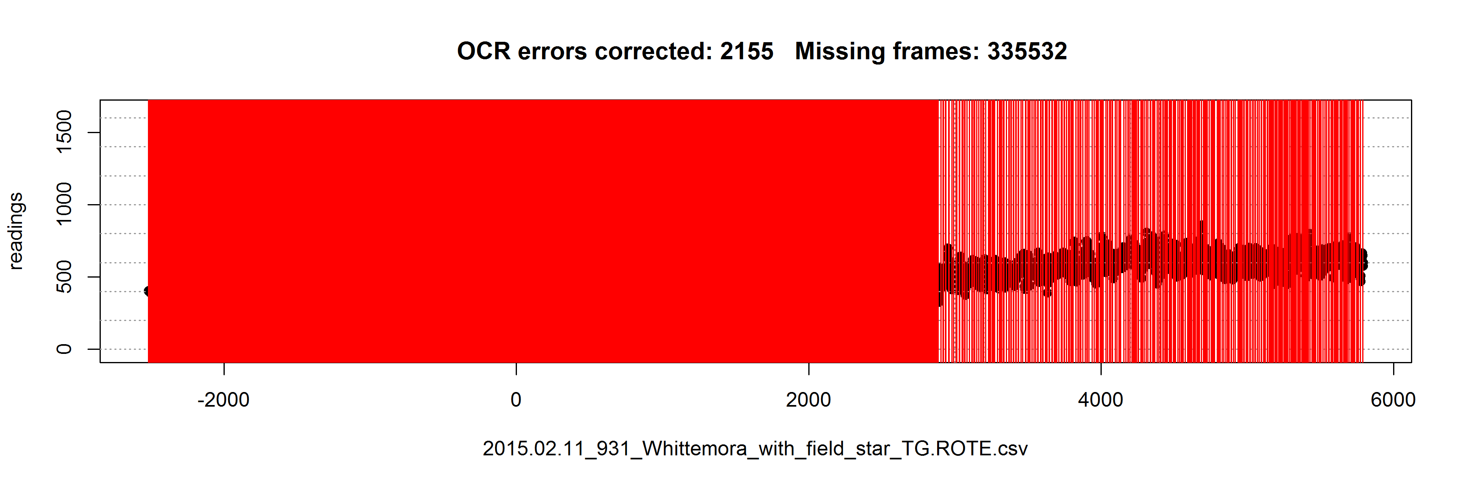
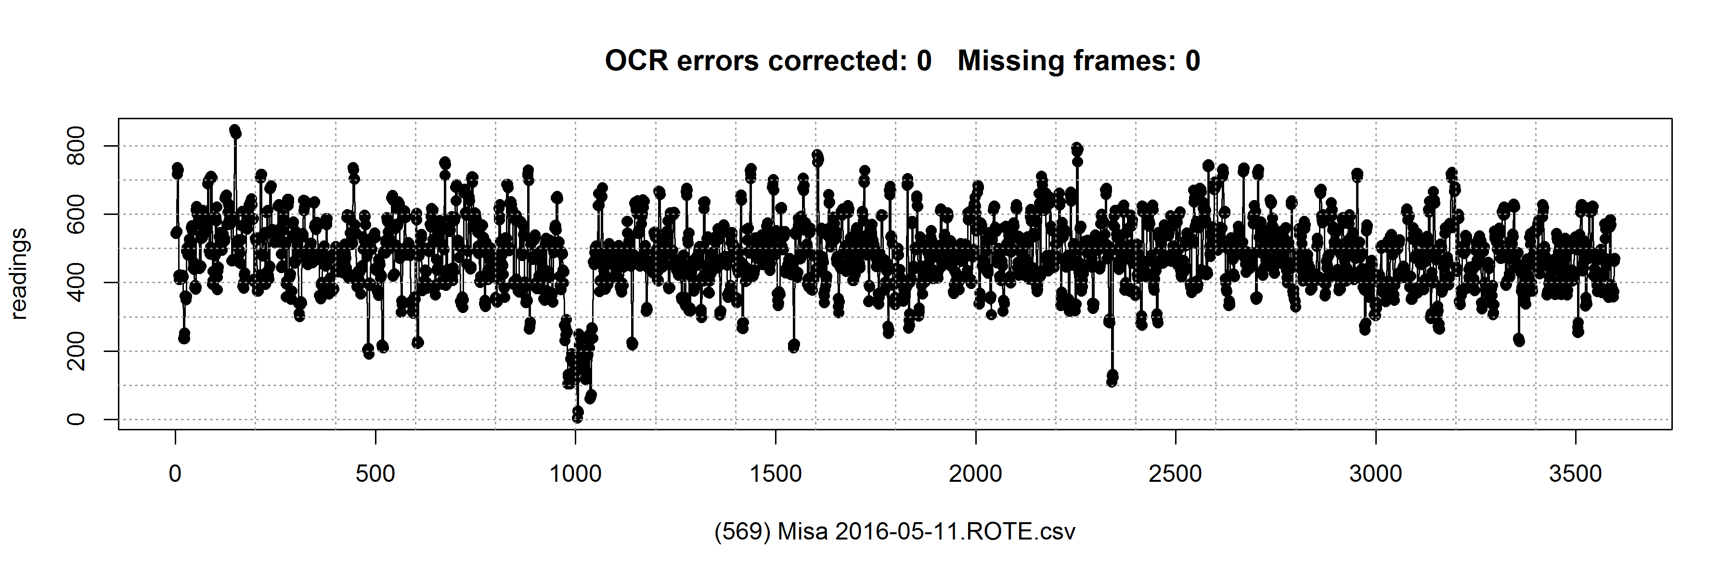
Time stamp continuity checks

Slide 16
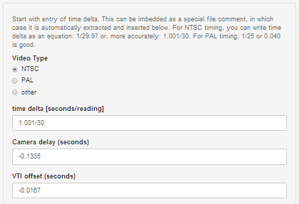
Camera delay and VTI offset corrections added
Entry boxes for Camera delay and VTI offset corrections are provided
D (seconds) = 38.471767 - 0.133500 (camera delay) - 0.016700 (VTI offset) = 38.321567 @ 2016-03-05 02:09:39.908566
R (seconds) = 40.006633 - 0.133500 (camera delay) - 0.016700 (VTI offset) = 39.856433 @ 2016-03-05 02:09:41.443433
Camera delay and VTI offset corrections are automatically applied to the D and R reported times

Slide 17
Normalization of primary star to secondary star (Jupiter PHEMU I ecl III)
Original Primary
Light curve
Original Secondary
Light curve
Normalized Primary
Light curve

Slide 18
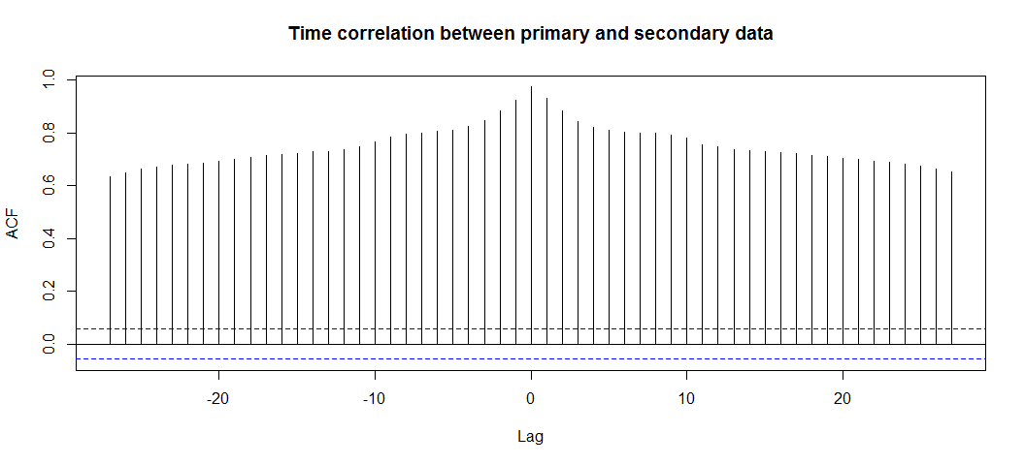
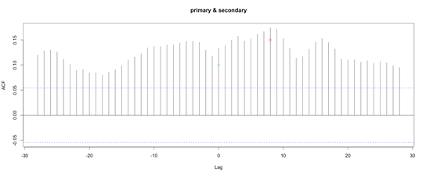
Time correlation of primary light curve to secondary light curve
Light curve with ‘zero’ offset between the primary and secondary light curves
Light curve with a positive ‘eight frame’ offset between the primary and secondary light curves

Slide 19
Correlated noise major improvement in error bars
Scintillation noise is often temporally correlated when measured at video frame rates through the typical amateur telescope of small diameter.
The term temporally correlated means that the residual noise at reading n depends to some extent on the noise at reading n-1 (the previous reading).

Slide 20
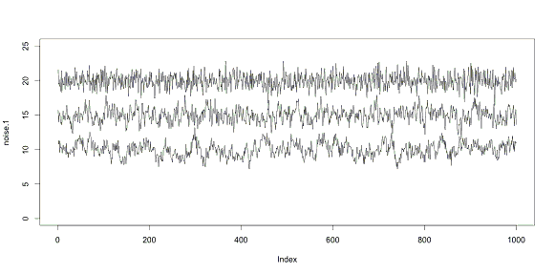
Graphical comparison of light curves with varying degrees of temporal auto-correlation representative of varying levels of atmospheric scintillation:
Zero temporal autocorrelation. ACF factors: 1.0
Slight temporal autocorrelation. ACF factors: 1.0, 0.40
Moderate temporal autocorrelation. ACF factors: 1.0, 0.5, 0.3, 0.2, 0.1, 0.05
Each light curve has the same exact amount of Gaussian noise, except they vary by the amount of temporal auto-correlation.

Slide 21
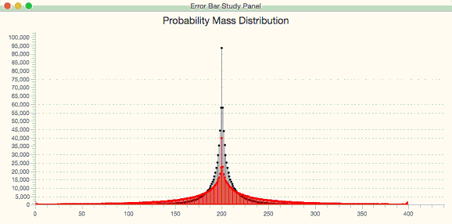
Graphical comparison of the effect of temporal auto-correlation on the distribution plot of errors
In the above graphic, the black error-bar distribution is the result of 1-million Monte Carlo simulations of an occultation event with a signal-to-noise level of 0.5, using zero temporal correlation.
The red error-bar distribution is the result of the same 1-million Monte Carlo simulation done but with fairly strong (but not atypical) temporal coherence like that which is often present in IOTA occultation light curves.

Slide 22
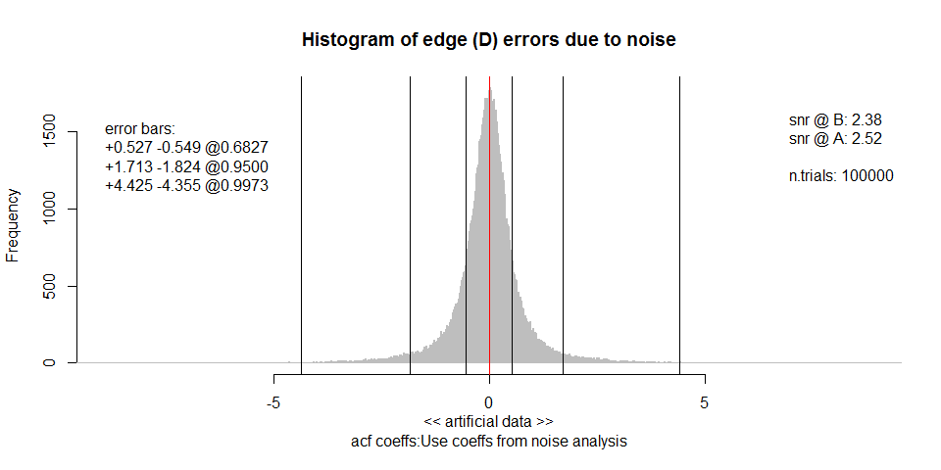
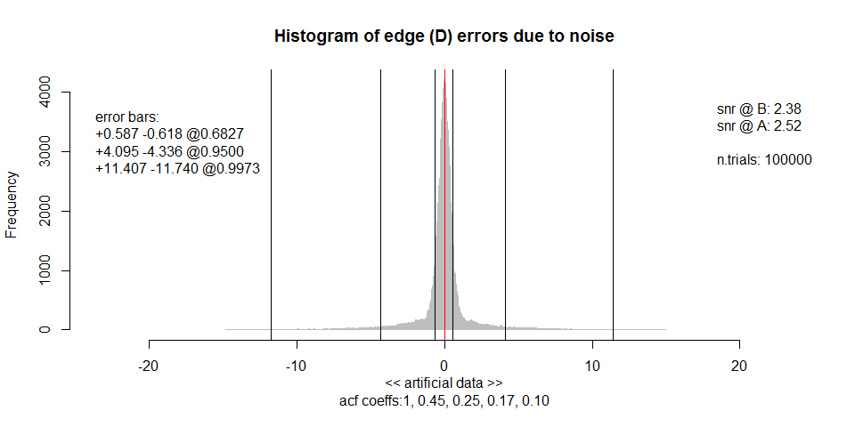
Comparison of light curves and error bar distributions, without and with temporal auto-correlation.
Top curve is the idealized light curve
Middle curve has Gaussian noise with no temporal auto-correlation
Bottom curve has temporal auto-correlation added with acf coeff: 1, 0.45, 0.25, 0.17, 0.10
No noise
Gaussian noise
Gaussian noise + auto-correlation

Slide 23
Comparison of error bars generated for light curve without correlated noise to light curves with correlated noise
Noise Present | 0.6827 error bar | 0.9500 error bar | 0.9973 error bar
Gaus-Equiv | 1-sigma | 2-sigma | 3-sigma
Gaussian | 0.55 | 1.84 | 4.65
Gaussian + auto-corr | 0.59 | 4.49 | 11.95
Ratio Gaussian +/ Gaussian | 1.07 | 2.44 | 2.57
Note: Steve Preston has requested that all error bars be reported at the 0.9973 confidence interval – the 3-sigma equivalent confidence interval
For all instances examined in R-OTE, light curves with correlated noise (which is representative of virtually all amateur observations) have larger error bars than light curves without correlated noise. At the 3-sigma equivalent confidence interval, correlated noise produces error bars that are 2.6 times larger than those calculated with non-correlated noise. OTEs such as Occular and AOTA do not process error bars with correlated noise, hence the error bars generated by these tools are under estimating the size of the error bars.

Slide 24
SQ wave error bars now user selectable between 0.5 and 0.9973 confidence intervals

Slide 25
Camera integration can be simulated in generated light curves
Original simulated light curve with typical correlated noise
Original simulated light curve with 4-frame integration

Slide 26
Camera integration can be simulated in generated light curves (continued)
Original simulated light curve with 8-frame integration

Slide 27
Where to find R-OTE
R-OTE is provided in a complete .zip file release package posted here:
http://www.asteroidoccultation.com/observations/Downloads/download-ROTE.php
The release package includes
a stand-alone User Manual in .chm format
Read_Me file for initial start up
Folder of test files for user testing when following the User Manual examples

Slide 28
Conclusions
R-OTE is a multi-purpose tool for analyzing occultation light curves.
The latest correlated noise error bar improvements in R-OTE make it the most advanced and complete occultation timing extraction program available to amateurs.
The large variety of features and the complexity of the GUI in R-OTE make it more difficult for beginners to learn. Occular or AOTA are better/easier tools for beginners, but both calculate error bars that are underestimated compared to R-OTE.

Slide 29
Thank you Bob Anderson for creating and improving ROTE

